Slide 1
Accelerate Testing Cycles With Collaborative Performance Testing
Rick Cavallaro

Slide 2

Agenda
Introduction
Collaborative Test Planning
Collaborative Test Execution
Collaborative Performance Analysis & Tuning
Summary
Q&A

Slide 3
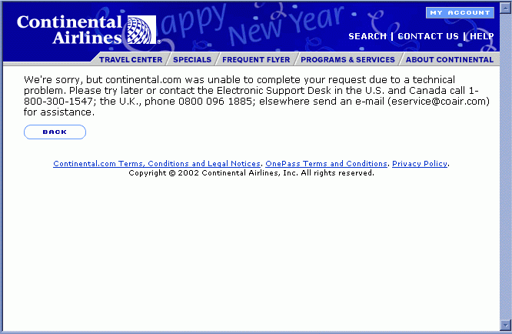
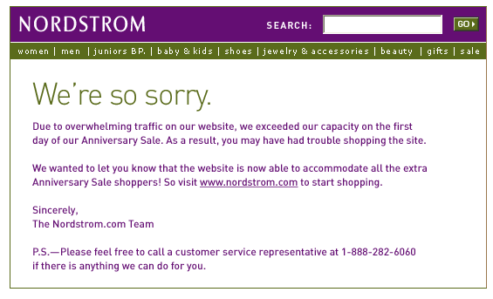
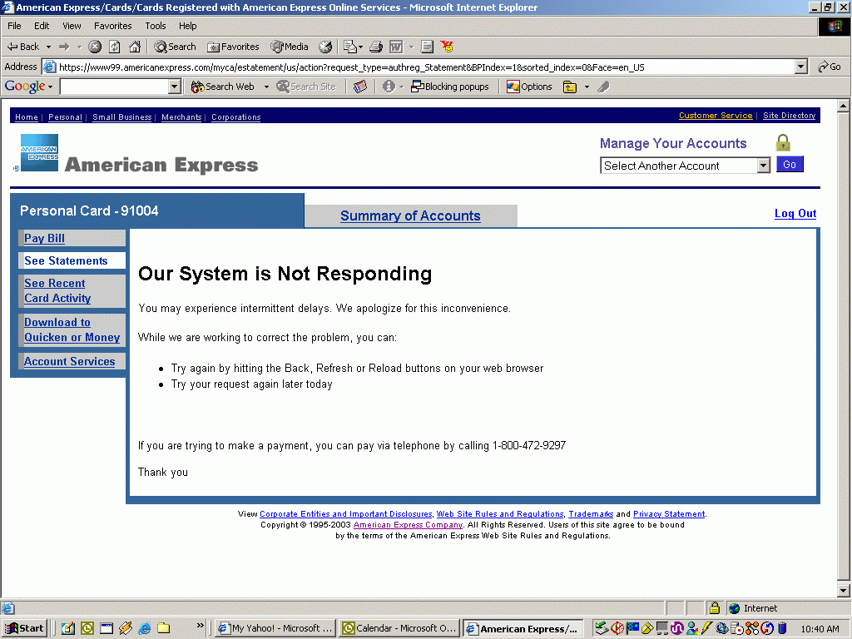
Poor Performance Affects Customer Perception …

Slide 4

… While Also Negatively Impacting the Bottom Line
Cost of 1 hour unplanned downtime - $100,000 (and could be significantly higher based on application)
Incremental cost of fixing problems can be 80-10,000X higher once in production
80% of unplanned downtime can be eliminated through pre-deployment testing and better QA/Development collaboration
75% of applications still deployed without formal testing
Source: Gartner & Forrester
Notes:
Forrester “The State of Retailing Online 7.0 Executive Summary”

Slide 5
Quick Audience Survey
Does your organization execute performance tests prior to deploying their Web applications?
How many people and which groups are involved in the performance testing process?
Would you describe your recent performance testing activities as successful? Why or why not?

Slide 6
Introduction
When executed properly, performance testing is critical to ensuring a successful deployment
Most often however performance tests are not executed properly (if at all) and no formal test process exists
Critical application team members (including Developers, Architects, DBAs, IT/Operations, etc.) do not feel engaged or even play a role in the process
A collaborative approach to performance testing can accelerate testing cycles and yield higher performing applications

Slide 7
Agenda
Introduction
Collaborative Test Planning
Collaborative Test Execution
Collaborative Performance Analysis & Tuning
Summary
Q&A

Slide 8
Collaborative Test Planning
Key questions that need to be answered before you test (the 4Ws and 1H of Test Planning)
  What are we testing?
  Why are we testing it?
  How are we testing it?
  When and Where will the tests be run?
  Who needs to be involved?
These questions cannot be answered in isolation – a collaborative team effort is needed
  Determining the answers to these questions is critical to success

Slide 9
Answering the “What”
What are we testing?
Need | Who to Work With | Usage
Application requirements | Product Managers, Business Analysts, Development Manager, Customers | Determining what to test, expected results, pass/fail criteria
Common use cases, usage scenarios | Product Managers, Business Analysts | Script creation, defining test scenarios
Application architecture / design specification | Development Manager, Architects, Developers | Performance analysis, tuning, test setup

Slide 10
Answering the “Why”
Why are we testing it?
Need | Who to Work With | Usage
Company needs / objectives / goals | Product Manager, Application Owner | Understanding service level agreements, customer expectations
Test objectives / goals | Development Manager, QA Manager, Architects/ Developers | Creating test plan, defining test scenarios, performance analysis

Slide 11
Answering the “How”
How are we testing it?
Need | Who to Work With | Usage
Test plan | QA Manager, Performance Engineers, Other Testers | Guide the testing effort, prioritize testing activities
Test hardware | QA Team, IT/Operations | Load controller, load test agents to run VUs, performance monitors
Testable application | Development Manager, Developers | Production environment or representative staging environment to test against; stable!

Slide 12
Answering the “When” and “Where”
When and Where will the tests be run?
Need | Who to Work With | Usage
Project schedule | Project Manager, Development Manager | Identify when testing will occur, understand overall project/dev milestones
Detailed test schedule | QA Manager, Project Manager | Further define test scenarios, outline specific timeframe for tuning / retests
Test Lab | QA Manager, IT/Operations | House the test hardware used to run test, host application under test
Contingency plans | Development Manager, Developers | Plan for (un)expected development delays, prioritize test efforts

Slide 13
Answering the “Who”
Who needs to be involved?
Team Member | Role
Performance Testers / QA | Create test plan, design tests / scripts, execute tests, gather results
Architects & Developers | Troubleshoot application failures, analyze application performance / business logic
DBA(s) | Troubleshoot database issues, analyze DB performance
IT / Operations | Troubleshoot hardware and network issues, aid in capacity planning
Project Manager | Manage the overall development / test effort, create project schedule, manage milestones
QA Manager | Manage the test team, assign testers, enable collaboration with development
Development Manager | Manage the development team, allocate resources to test effort, help determine goals

Slide 14
Agenda
Introduction
Collaborative Test Planning
Collaborative Test Execution
Collaborative Performance Analysis & Tuning
Summary
Q&A

Slide 15
Collaborative Test Execution
Common Load Test Practice #1 (stop me if you’ve heard this one before)
  Plan your load test (define scenarios, pass/fail criteria, …)
  Prepare to run tests (create scripts, set up server monitors, prepare test environment, …)
  Run your tests (run specific load scenarios, ramp VUs, monitor throughput,…)
  Collect results and identify failures (scenario “x”, fails at load level “y”, under the conditions “z”, …)
  Gather data and send to architect/developers for deeper analysis
  Architect/developers dismiss or don’t believe results
  Get asked to go run your test again
  Go back to Step 1 (lather … rinse … repeat …)

Slide 16
Collaborative Load Test Execution
Rule #1: People (developers, architects, DBAs, …) who are not engaged in the test process will not be engaged or feel ownership for the results.
Rule #2: Testing and tuning the performance of enterprise Web applications is a complex and iterative process.
Rule #3: “Breaking” the application and identifying failures is not the desired outcome; finding bottlenecks, tuning the application and maximizing performance is!
Therefore: Tester, developers, architects and others need to work together to analyze load test results, tune the application and re-run tests to validate changes

Slide 17
Typical Load Test Scenario
Install &
Preparation
Run
Tests
Collect
Results
Analyze
Performance
Tune
Application
Deploy
Application
Testers
Developers / Architects / DBAs / IT Operations
Problems with this Approach:
People running tests and gathering results are not engaged with those that may be needed to analyze data and identify root case
Analysis & tuning is complex and often requires real time data analysis
Its easier to dismiss poor or failing results after the fact than when they are occurring

Slide 18
Ideal Load Test Scenario
Collaborate during testing, analysis and application tuning
Install &
Preparation
Run
Tests
Collect
Results
Analyze
Performance
Tune
Application
Deploy
Application
Testers / Developers / Architects / DBAs / IT Operations …
Advantages:
Enables real-time performance analysis and tuning by entire team
Reduces test cycle times and communication delays between test & development
Yields higher performing applications

Slide 19
Collaborative Load Test Execution ::
Making it Happen
If it’s that easy, why isn’t everyone doing it?
  Don’t understand the objectives of the test
    “What are we trying to prove here? Why is this considered a failure?”
  Lack of trust in the testing tools and results
    “It can’t be the application, it must be the testing tools.”
  Lack of trust in the testers
    “This can’t be right, you must have done something wrong.”
  Feel that it’s unnecessary
    “My Application design is bullet-proof.” –or- “We’ve added so much extra capacity on server side it doesn’t matter.”
  No time to participate
    “Go away.”

Slide 20
Collaborative Load Test Execution ::
Making it Happen
Keys to enabling a collaborative load test process
  Step 1: Establishing Credibility
    Gain and then demonstrate a clear understanding of the application and its requirements (functional and performance)
  Step 2: Gaining Consensus on the Test Process
    Clearly define the goals of the test, expected results and pass/fail criteria and make sure everyone is on board
  Step 3: Getting Buy-In on the Tools & Methods
    Identify the tools you will be using to test, provide any relevant documentation, and if necessary do a demo in advance to show how things will work
  Step 4: Establishing the Value of the Test
    Outline how you plan to target specific critical areas of the application and how you will identify application and server capacity issues combining both Virtual User load and server-side monitors
  Step 5: Making it Convenient
    Provide real-time status of tests in progress, enable real-time viewing of results, and make it easy for people to participate (IM, Web share, Web enabled tools)

Slide 21
Agenda
Introduction
Collaborative Test Planning
Collaborative Test Execution
Collaborative Performance Analysis & Tuning
Summary
Q&A

Slide 22
Collaborative Performance Analysis & Tuning
Remember Rule #3 (there will be a test later)
  Rule #3: “Breaking” the application and identifying failures is not the desired outcome; finding bottlenecks, tuning the application and maximizing performance is!
So how do we do that?
  Get the right people, working collaboratively, to get the job done (Collaborative Test Planning and Execution)
  Give them the data they need to be successful (Collaborative Performance Analysis and Tuning)

Slide 23
Three Levels of Performance Diagnostics for Analysis and Tuning
Level 1: Analyze Performance and Response Times from the End-User Perspective
Level 2: Analyze Performance of Your Back-end Infrastructure
Level 3: Analyze Performance and Response Times of Server-side Transactions
Each level provides another layer of data that will be relevant to different team members

Slide 24
Three Levels of Performance Diagnostics for Analysis and Tuning
Level 1: Analyze Performance and Response Times from the End-User Perspective
  Provides standard load test metrics for script/page/object level response times, throughput, concurrency, etc.
  Easiest to relate to and reflect actual end-user experience
  Tests the entire application and infrastructure as a system
  Load scenarios and individual scripts can be designed to identify specific application bottlenecks
Who needs this data?
  Testers: To report test results and relate them to application requirements and test objectives
  Development Team: To identify general performance limitations and start troubleshooting bottlenecks
  Project Managers / Others: To begin understanding how the application will behave once deployed to production.

Slide 25
Three Levels of Performance Diagnostics for Analysis and Tuning
Level 2: Analyze Performance of Your Back-end Infrastructure
  Provides key server and network performance metrics for measuring CPU, memory, bandwidth, number of connections, queued requests, etc.
  Allows you to understand server-side resource utilization
  Lets you target individual servers or network components, generally without having to install anything (agent-less)
  Use in conjunction with Level 1 metrics to correlate client-side performance degradation to serve-side bottlenecks
Who needs this data?
  Testers: To provide a complete view of application performance from both client and server side
  Development Team: To more easily trace performance issues to specific tiers / components in the application infrastructure
  IT Operations Team: To understand server and network capacity issues and size accurately for production deployment

Slide 26
Three Levels of Performance Diagnostics for Analysis and Tuning
Level 3: Analyze Performance and Response Times of Server-side Transactions
  Provides profiling-level data to view actual transaction response times of individual objects, methods and database queries
  Allows you to understand where time is being spent within the individual server component
  Lets you target actual business logic and identify problems in the code impacting performance
  Use in conjunction with Level 1 and 2 metrics to correlate client and server side performance degradation to application business logic
Who needs this data?
  Architects: To identify issues in the design of the business logic that may be limiting performance
  Developers: To identify issues in specific functions or methods that may be creating performance bottlenecks
  DBAs: To identify queries or commands that may be optimized to reduce data access times and improve performance

Slide 27
Collaborative Performance Analysis & Tuning
Providing data at different levels of granularity will aid team in quickly analyzing bottlenecks
Giving individuals data specific to their areas of need or interest will also drive greater participation and buy-in
Bringing the team together to collaboratively analyze data and make tuning recommendations will yield better performing applications in less time

Slide 28
Authoria Experience
Web-based HR software provider
Development and QA teams dispersed across India, Mass. and Calif.
“Being able to cooperatively analyze what’s going on during a test helps us respond more efficiently to customer needs …. With e-TEST suite 8.0, we have cut performance testing time by two-thirds…. This gives Authoria a competitive advantage because we can deliver extremely high quality solutions far more quickly.”

Slide 29
Summary
Testing and tuning the performance of enterprise Web applications is a complex and iterative process
Tester, developers, architects and others need to work together to collaboratively plan the testing effort, execute tests, and analyze results to tune performance
Collaboration is critical to the success of the team and each member needs to be engaged in the process
Collaborative load testing can ultimately yield better performing applications in less time

Slide 30
Thank You!

